Slide 1
Macroeconomics Review

Slide 2
Macroeconomic Concepts
SSEMA1 The student will illustrate the means by which economic activity is measured.
a. Explain that overall levels of income, employment, and prices are determined by the spending and production decisions of households, businesses, government, and net exports.
b. Define Gross Domestic Product (GDP), economic growth, unemployment, Consumer Price Index (CPI), inflation, stagflation, and aggregate supply and aggregate demand.
c. Explain how economic growth, inflation, and unemployment are calculated.
d. Identify structural, cyclical, and frictional unemployment.
e. Define the stages of the business cycle, include peak, contraction, trough, recovery, expansion as well as recession and depression.
f. Describe the difference between the national debt and government deficits.
SSEMA2 The student will explain the role and functions of the Federal Reserve System.
a. Describe the organization of the Federal Reserve System.
b. Define monetary policy.
c. Describe how the Federal Reserve uses the tools of monetary policy to promote price stability, full employment, and economic growth.
SSEMA3 The student will explain how the government uses fiscal policy to promote price stability, full employment, and economic growth.
a. Define fiscal policy.
b. Explain the government’s taxing and spending decisions.

Slide 3
SSEMA1
The student will illustrate the means by which economic activity is measured.

Slide 4
SSEMA1
a. Explain that overall levels of income, employment, and prices are determined by the spending and production decisions of households, businesses, government, and net exports.

Slide 5
Circular Flow Model

Slide 6
How is economic activity measured?
Gross Domestic Product (the main measure)
Sometimes other measures are useful
GDP is used to derive many of them.
Gross National Product
Net National Product
National Income
Personal Income
Disposable Personal Income

Slide 7
SSEMA1
b. Define Gross Domestic Product (GDP), economic growth, unemployment, Consumer Price Index (CPI), inflation, stagflation, and aggregate supply and aggregate demand.

Slide 8
GDP
Gross= total
Domestic= produced anywhere in the 50 states, by anyone
Product= final goods and services

Slide 9
What does GDP measure?
Total amount of final goods and
services produced in a country
in one year.
(Measure of Output)

Slide 10
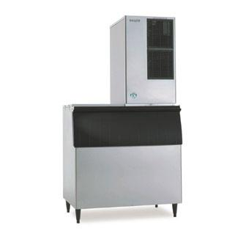
What is counted in GDP?
FINAL goods
and services
Goods/Services produced
here, even if by a foreign co.

Slide 11
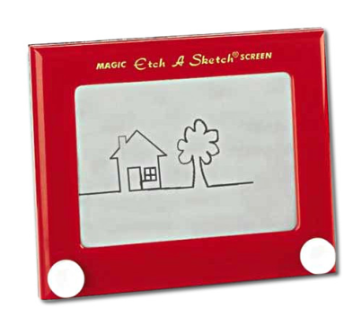
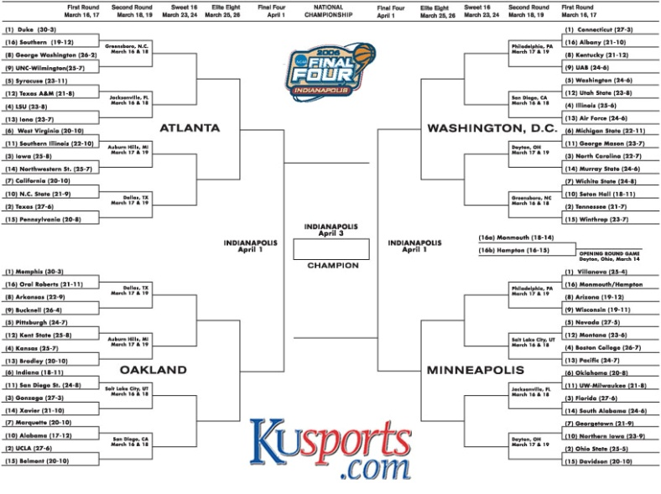
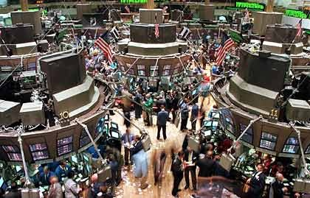
What is NOT counted?
Things produced outside the
country.
Illegal stuff
Purely financial transactions
Pay a broker – broker part counts
Stock itself doesn’t count

Slide 12
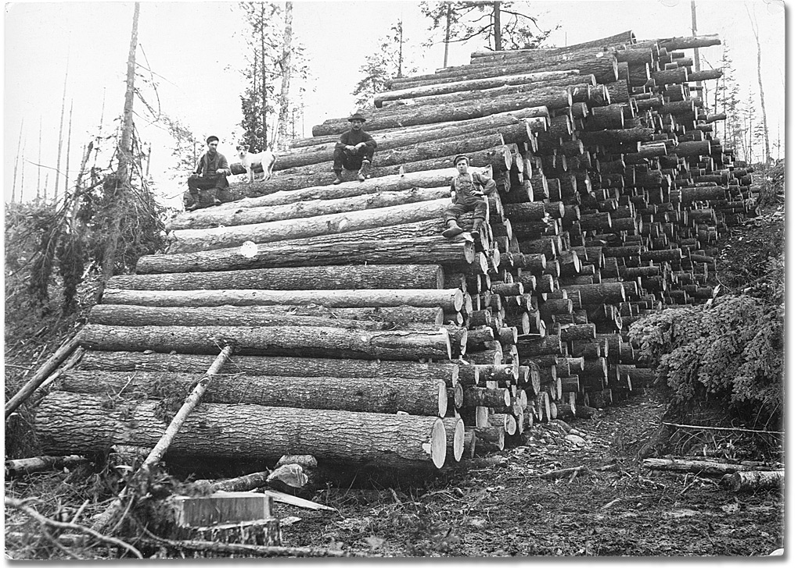
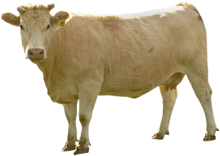
…and INTERMEDIATE GOODS

Slide 13
C + I + G + (X – M)
C= consumption spending
(think consumers)
72%
I= investment spending
(think businesses investing in themselves)
15%
G= government spending
17%
(X-M)= difference between exports and imports
-4%

Slide 14
Real and Nominal GDP
Nominal GDP is measured in current year’s prices.
Real GDP is measured in constant or unchanging prices (more accurate).
Inflation distorts
10 oranges @ $1 = $10
10 oranges @ 3 = $30
Is our economy better?
NO – inflated!!

Slide 15
Economic Growth : steady, long-term increase in real GDP.
Unemployment: not having a job, while actively seeking work.
Consumer Price Index: price index determined by measuring the price of a standard group of goods meant to represent the typical “market basket” of a typical urban consumer. (measures inflation)
Base year 100
Numbers over 100 show inflation, under 100 shows deflation
Inflation: a general increase in prices
Stagflation: decline in real GDP combined with a rise in the price level.
Aggregate Supply: total amount of goods and services in the economy available at all possible price levels.
Aggregate Demand: total amount of goods and services in the economy that will be purchased at all possible price levels.
WHOLE economy, not one business/one individual/one product

Slide 16
SSEMA1
c. Explain how economic growth, inflation, and unemployment are calculated
Economic Growth = Real GDP
Inflation = CPI
Unemployment = Unemployment Rate

Slide 17
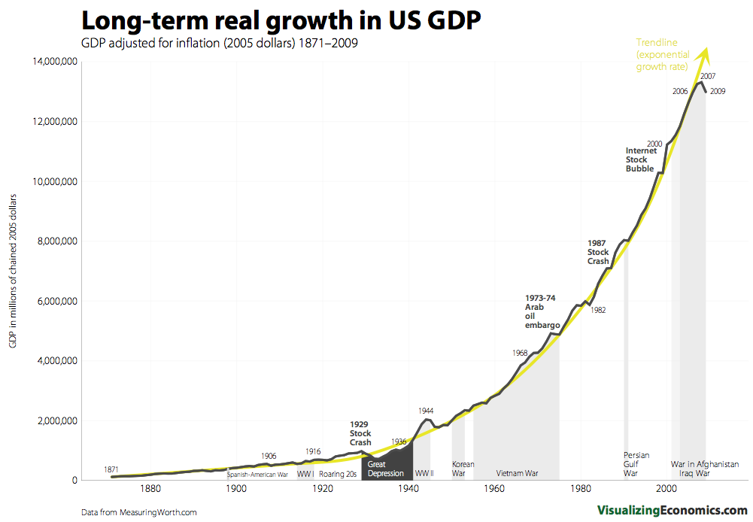

Slide 18
SSEMA1
d. Identify structural, cyclical, and frictional unemployment.

Slide 20
UNEMPLOYMENT
Types of unemployment
Frictional – when people change jobs or get laid off (between jobs, left one to take another)
Structural – when the skills of workers do not match the jobs that are available (big change in economy, change in the business, like a merger, or a closure.)
Seasonal – when a period of steady work is followed by a period of unemployment each year. Takes place every year, regardless of the economy.
Cyclical – when unemployment rises during economic downturns and falls when the economy improves (recession – people put off buying cars, etc. so people lose jobs). Can last 3-5 years.

Slide 21
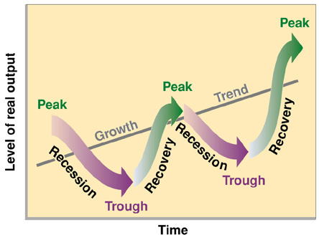
SSEMA1
e. Define the stages of the business cycle, include peak, contraction, trough, recovery, expansion as well as recession and depression.

Slide 22
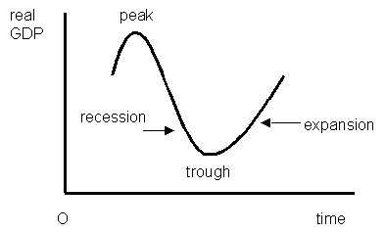
Phases of the Business Cycle
Peak = height of expansion, GDP stops rising.
Contraction = economic decline, falling real GDP, unemployment, fall in business activity.
Trough – lowest point in contraction, real GDP stops falling.
Expansion – growth, rise in real GDP, increased employment and income.

Slide 23
Other terms associated with business cycles
Economic growth – period of steady, long term increase in real GDP.
Recession – prolonged economic contraction. Real GDP falls for two consecutive quarters (6 months)
Depression – recession that is especially long and severe.
Stagflation – decline in GDP combined with a rise in price level.

Slide 24
SSEMA1
f. Describe the difference between the national debt and government deficits

Slide 25
What’s the difference between the national debt and the deficit?
Debt – the total amount of money the federal government owes to bondholders. (government borrows each year to cover the deficit) We owe investors who hold government bonds. It’s what we owe for all the years in existence added together!
Deficit – the amount of money the government borrows for one budget, one year – the amount overspent in a year.

Slide 26
SSEMA2
The student will explain the role and functions of the Federal Reserve System.

Slide 27
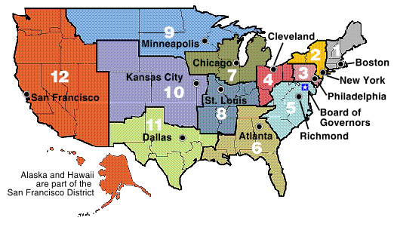
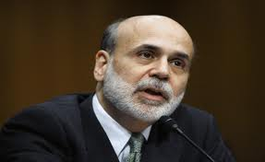
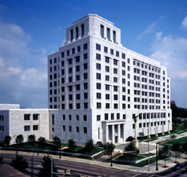
SSEMA2
a. Describe the organization of the Federal Reserve System.

Slide 28
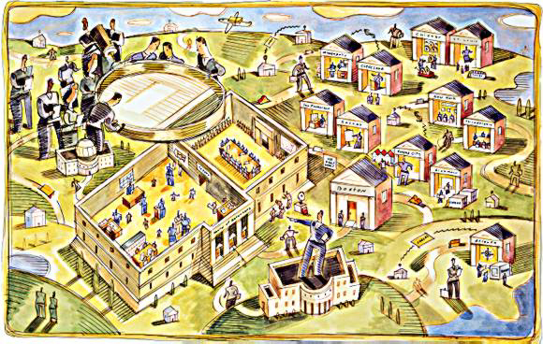
What is the Fed?
Central bank of the United States
Established in 1913
Purpose is to ensure a stable economy for the nation
Notes:
What is the Fed?
The Federal Reserve is the central bank of the United States and its purpose is to help ensure a stable economy for the nation.
Established as a result of the Federal Reserve Act, signed in 1913.
Receives no congressionally appropriated funds. Its operations are financed primarily from the interest earned on the U.S. government securities it acquires in the course of its monetary policy actions.
Another major source of income is derived from the fees received for certain services provided to depository institutions.
After payment of certain expenses, all the net earnings of the Federal Reserve Banks are transferred to the U.S. Treasury. In 2004, for example, the Fed paid approximately $18.1 billion to the U.S. Treasury.

Slide 29
Federal Reserve System Structure
Board of Governors
12 Reserve Banks
Federal Open Market Committee
Notes:
The Board of Governors in Washington, D.C. oversees the activities of the twelve independently operated District Reserve Banks across the country.
Each of the 12 Federal Reserve Banks is separately incorporated with a Board of Directors. The District Federal Reserve Banks, along with their 25 branches, are located in major cities across the country, giving the System a strong grass-roots foundation.
The Federal Open Market Committee (FOMC) is the chief policymaking body of the Federal Reserve System.

Slide 30
SSEMA2
b. Define monetary policy.
Action taken by the Federal Reserve System to influence the money supply and economic growth

Slide 31
Monetary Policy
Policy changes affect the nation’s supply of money and credit.
Actions have real short- and long-term effects on the economy.
Notes:
What is monetary policy?
The Fed manages the nation’s money supply to keep inflation low and the economy growing at a sustainable rate.
The actions that the Fed takes today influence the economy and the inflation rate for some time to come. Consequently, policymakers must be forward-looking and must take pre-emptive action to head off inflation before it gathers momentum

Slide 32
SSEMA2
c. Describe how the Federal Reserve uses the tools of monetary policy to promote price stability, full employment, and economic growth.
Open Market Operations – Buy Bonds (Bigger Bucks, increase MS), Sell Bonds (Smaller Bucks, decrease MS)
Discount Rate – raise it (lowers $ Supply), lower it (increase $ Supply)
Reserve Requirement – raise it (decrease $ Supply), lower it (increase $ supply)

Slide 33
Goals of Monetary Policy
Full
Employment
Stable Prices
Sustainable Economic Growth
Notes:
Monetary policy is designed to effectively promote the goals of maximum employment, stable prices, and sustainable economic growth.
The Fed is consistently striving for a balance between oftentimes conflicting goals of monetary policy
For example, if the economy is growing at too rapid a pace, the Fed may dampen that growth by influencing interest rates to rise, which may have the effect of putting some people out of work—a direct challenge to the goal of maximum employment.

Slide 34
SSEMA3
The student will explain how the government uses fiscal policy to promote price stability, full employment, and economic growth.

Slide 35
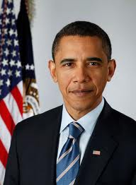
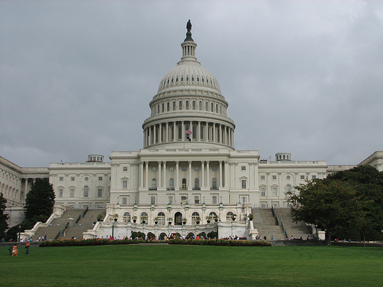
SSEMA3
a. Define fiscal policy: use of government spending and revenue collection to influence the economy.

Slide 36
SSEMA3
b. Explain the government’s taxing and spending decisions.
Expand the economy
Increase Spending
Lower Taxes
Slow the economy
Increase taxes
Lower spending

